Slide 1

AWT PJ Video Streaming Mixer Library
Poonam Kumari Roy, Mohamed Mesto, Yuni Quintero | AWT PJ | Workshop 2

Slide 2
Agenda
Wrap up: Problem Statement
Proposed Solution
Tools
Data Structures
Functions
Details on the implementation
Algorithm A and B
Challenges
Demo
Schedule and Next Steps
Poonam Kumari Roy, Mohamed Mesto, Yuni Quintero | AWT PJ | Workshop 2

Slide 3
Wrap up: Problem Statement
Adaptive bitrate streaming standards, like HLS, provide a solution to avoid buffering while consuming video streams over the internet.
To enjoy multiple streams, these streams should be compatible with each other in terms of resolution.
We need to implement a strategy that finds and selects which streams are a match.
Poonam Kumari Roy, Mohamed Mesto, Yuni Quintero | AWT PJ | Workshop 2
Notes:
Adaptive bitrate streaming standards, like HLS, provide a solution to avoid buffering while consuming video streams over the internet.
HLS produces different versions of a video with lower, medium and high quality of resolution and bitrate. In order to enjoy multiple streams in a continuous manner without pausing, these streams should be compatible with each other in terms of resolution. Not every stream shares the same resolutions as the other.
We need to implement a strategy that finds and selects which streams are a match in order to combine them into a single one. We will use the hls-parser library to obtain, manipulate and create a new video stream text manifest with the final master playlist.

Slide 4
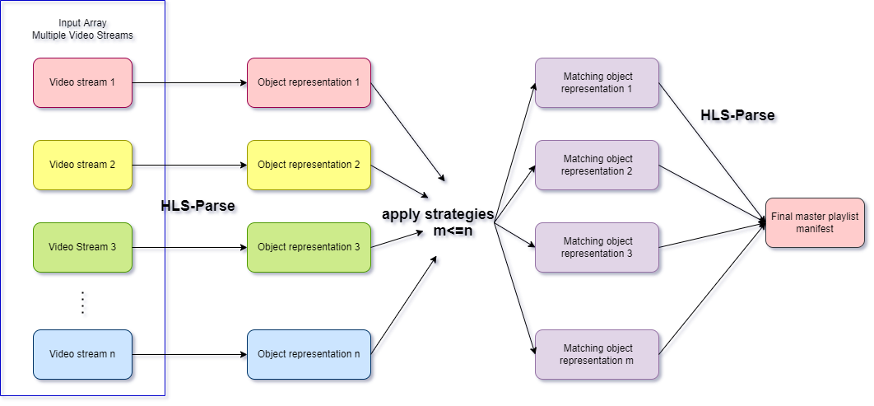
Proposed Solution
Strategy A: Match representations against first element of input array
Strategy B: Find intersection of representations
Poonam Kumari Roy, Mohamed Mesto, Yuni Quintero | AWT PJ | Workshop 2

Slide 5
Tools
IDE: Visual Studio Code
Version Control: Git
Programming language: Javascript
hls-parser library
Free HLS m3u8 URLs: https://ottverse.com/free-hls-m3u8-test-urls/
Poonam Kumari Roy, Mohamed Mesto, Yuni Quintero | AWT PJ | Workshop 2

Slide 6
Data Structures
URLs array: <String>[]
Variants Dictionary:
{key<Int>: value<Variant>[]}
The keys are the corresponding indexes of the URLs array and have as value an array of the different variants of a stream as an object representation
Objects array: <Playlist>[]
Filled with the object representation Playlist of the multiple streams
Poonam Kumari Roy, Mohamed Mesto, Yuni Quintero | AWT PJ | Workshop 2

Slide 7
Functions
run()
parseStreamData(Response) -> <Variant>[]
removeDuplicates(array) -> array
getResolutions(array) -> array
algorithmA()
algorithmB()
Poonam Kumari Roy, Mohamed Mesto, Yuni Quintero | AWT PJ | Workshop 2

Slide 8
Details on the Implementation
Define an array of video streams URLs.
Fetch the manifest text data from the urls.
Parse the manifest text into object representation with hls-parser.
Create the needed Data Structures: Object array and Variants Dictionary.
We execute algorithm A and B.
Poonam Kumari Roy, Mohamed Mesto, Yuni Quintero | AWT PJ | Workshop 2

Slide 9
Algorithm A
We need as a final output a master playlist that contains the exact same representations available from the first video stream of the input array.
Extract resolutions of the first element of the array from the Variants dictionary, these are our needed resolutions.
We iterate over the other streams and for each we will obtain its variants.
Then we compare each needed resolution against all the representations available for every other stream, checking if it is present.
We save the object representation of the matching streams into an array for later use.
Poonam Kumari Roy, Mohamed Mesto, Yuni Quintero | AWT PJ | Workshop 2

Slide 10
Algorithm B
We need as a final output a master playlist that contains the representations resulting from an intersection, if one exists, of all the streams’ variants.
From the variants dictionary we get the representations for each stream, making an array of arrays.
Then, for every stream representation we check if it exists in every other streams variants.
The number of times a representation should appear in the other streams in order to be in the intersection should equal to the amount of video streams minus 1.
If no representation is present in every stream, the intersection is empty.
Poonam Kumari Roy, Mohamed Mesto, Yuni Quintero | AWT PJ | Workshop 2

Slide 11
Challenges
Duplicated resolutions with different bitrate.
As the elements of the variants array are objects of type {width: Int, height: Int}, finding an algorithm to search for elements in the array and the intersection were not trivial. For loops were used to reach a working solution.
Poonam Kumari Roy, Mohamed Mesto, Yuni Quintero | AWT PJ | Workshop 2
Notes:
We are in early stage of our implementation, we first tried to find out our tools (resources) to achieve our possible solution , after that we face vast data with lots of duplicates item, we remove that.

Slide 12
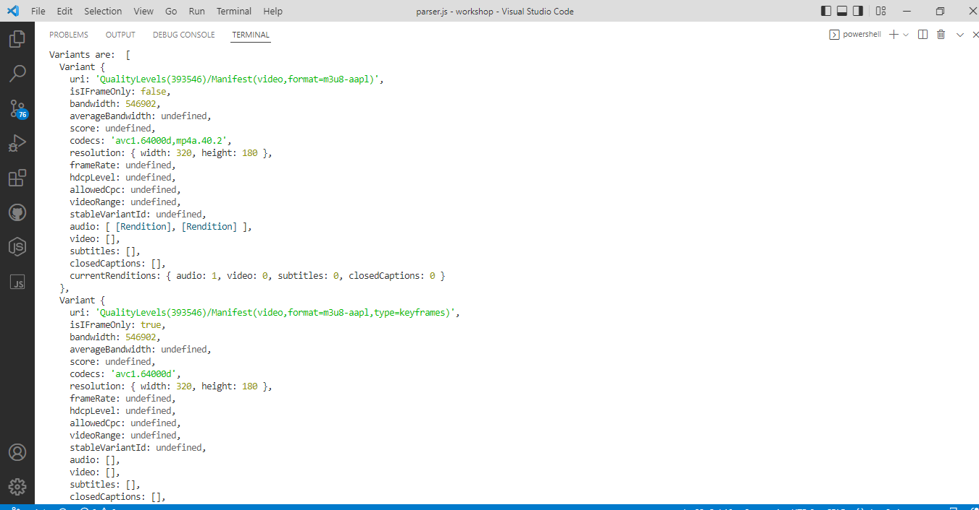
Demo
Poonam Kumari Roy, Mohamed Mesto, Yuni Quintero | AWT PJ | Workshop 2
Notes:
We have lots of variants with different attributes we are focusing on bandwidth and resolution for now to achieve our playlist for video streaming mixer library.

Slide 13
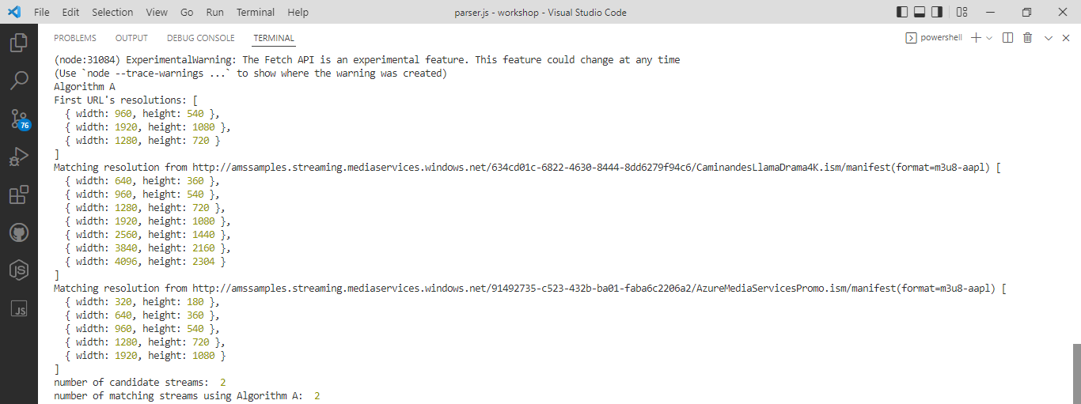
Demo
Poonam Kumari Roy, Mohamed Mesto, Yuni Quintero | AWT PJ | Workshop 2

Slide 14
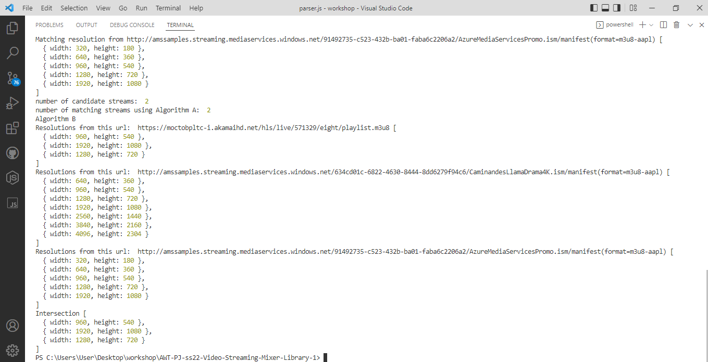
Demo
Poonam Kumari Roy, Mohamed Mesto, Yuni Quintero | AWT PJ | Workshop 2

Slide 15
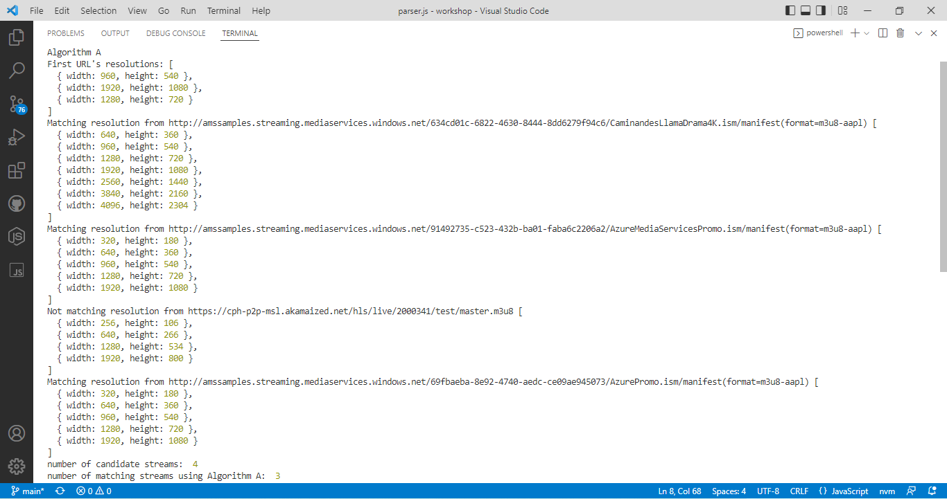
Demo
Poonam Kumari Roy, Mohamed Mesto, Yuni Quintero | AWT PJ | Workshop 2

Slide 16
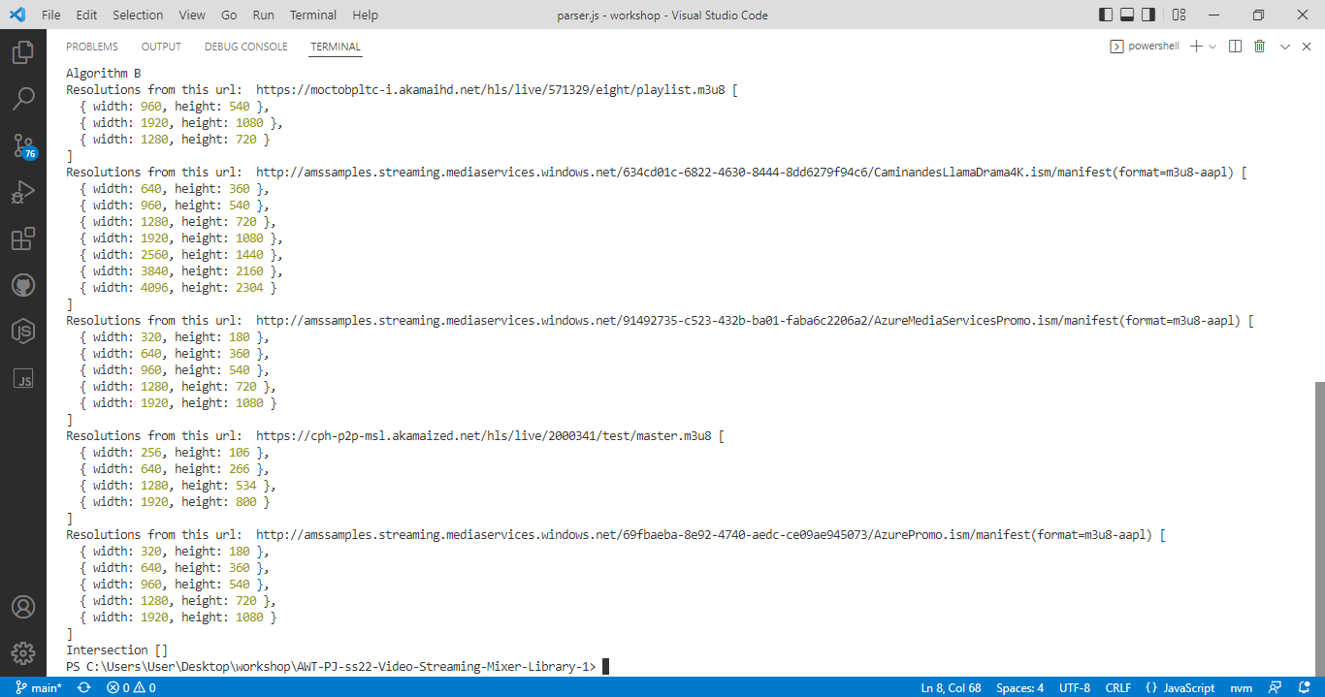
Demo
Poonam Kumari Roy, Mohamed Mesto, Yuni Quintero | AWT PJ | Workshop 2

Slide 17
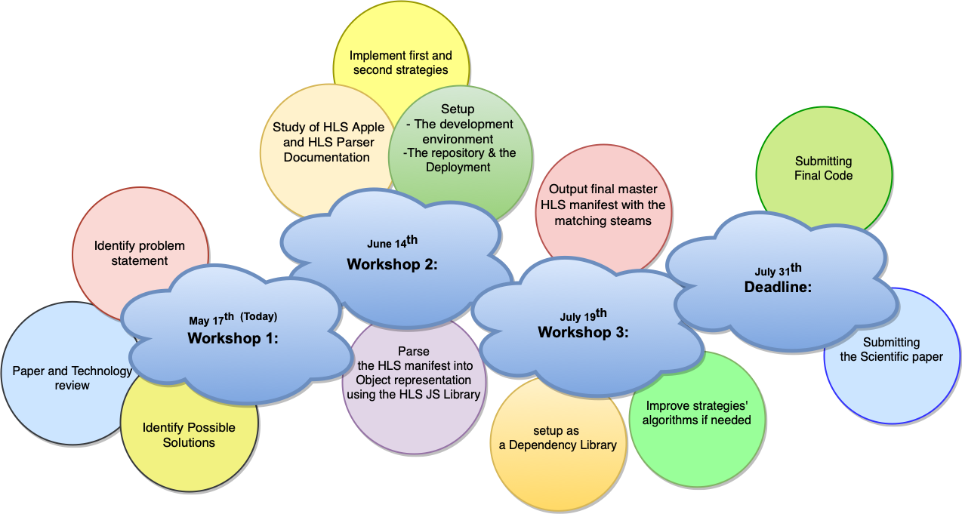
Schedule
Poonam Kumari Roy, Mohamed Mesto, Yuni Quintero | AWT PJ | Workshop 2

Slide 18
Next Steps
Refine and improve the algorithms if needed
Create and output final master playlist manifest using hls-parser with the matching streams from each strategy
Refactor code to deploy as a dependency. Algorithms A and B should receive URLs as parameters
Poonam Kumari Roy, Mohamed Mesto, Yuni Quintero | AWT PJ | Workshop 2

Slide 19
Resources
https://bitmovin.com/adaptive-streaming/
https://www.wowza.com/blog/adaptive-bitrate-streaming
HLS documentation https://datatracker.ietf.org/doc/html/rfc8216
hls-parse js library https://www.npmjs.com/package/hls-playlist-parser
R. Seeliger, D. Silhavy, Dr. S. Arbanowski “Dynamic ad-insertion and content orchestration workflows through manifest manipulation in HLS and MPEG-DASH” https://ieeexplore.ieee.org/document/8228708
https://developer.apple.com/documentation/http_live_streaming/about_apple_s_http_live_streaming_tools
Poonam Kumari Roy, Mohamed Mesto, Yuni Quintero | AWT PJ | Workshop 2

